Slide 1
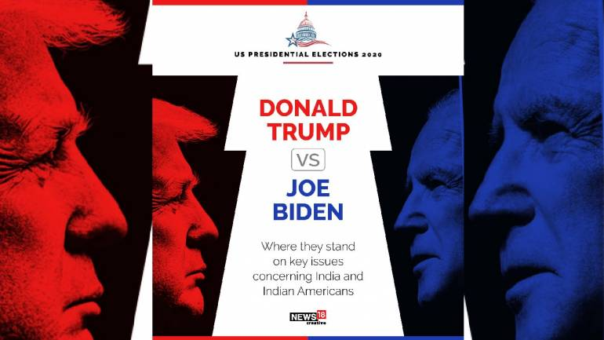
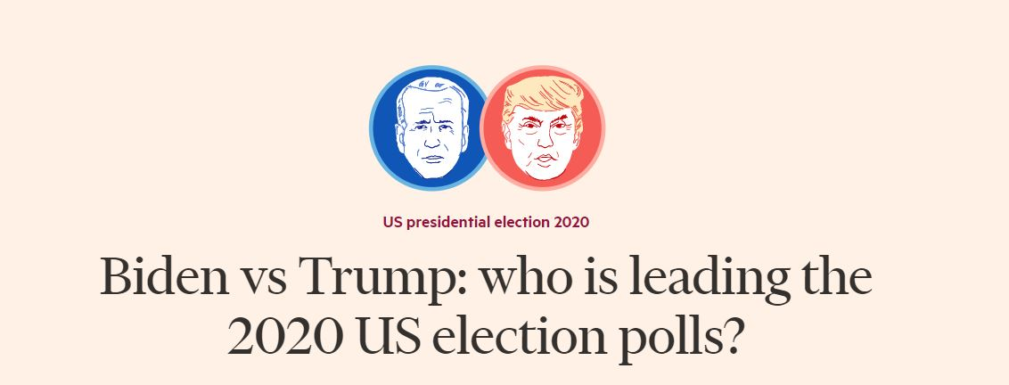

Slide 2






The team
“ we are the ones to solve the problem we identified”
Avinash Kumar
Nishtha Dua
Aditya Singh
E18CSE031
E18CSE119
E18CSE009

Slide 3

Introduction
US Elections is the most awaited election for the world.
Twitter being the most active platform for the politicians provides efficient data to analyse the mood of the nation.
With Donald Trump chasing his second term and Joe Biden active in the race, this is the most exciting event of 2020.

Slide 4
The problem
→ Analysing Twitter Sentiments
→ Implement Different Methods
→ Compare Results
Rep | Demo | Rep | Demo

Slide 5
Motivation
All the Opinion polls predicted landslide victory for Joe Biden
YouGov America
The website FiveThirtyEight
Reuters
CNN
90
52
52
53.2
44.3
42
44
10

Slide 6
Methodologies Used
Method 1
Method 2 and 3
Method 4 and 5
Lexicon based methods
Supervised machine learning methods
Bidirectional Text Classification method
Vader and
TextBlob
SVM and Naive Bayes
BERT

Slide 7
Methods Description
Vader - VADER(Valence Aware Dictionary for Sentiment Reasoning) is a lexicon based method to analyse sentiments based on the positive, negative and neutral metrics.
TextBlob - TextBlob is a python library used in text mining. It uses Natural Language ToolKit for achieving the results. TextBlob gives polarity[-1,1] and subjectivity[0,1] of texts. While polarity signifies the positive and negative sentiments, subjectivity defines about the text relevance.
Naive Bayes - Naive Bayes algorithm is based on Bayes Theorem.Using Bayes Theorem we can calculate the conditional probability of an event. It is finding probability of an event given how it is related to other events.
SVM- This supervised machine learning algorithm was chosen because it works well for text classification and is capable enough to handle large features. In out dataset it is being used to classify the tweets into positive and negative.
BERT- Bert stands for Bidirectional Encoder Representations from Transformers. It is bidirectional meaning that it learns information from left as well as right side of each token at the time of training. It works on transformer architecture

Slide 8

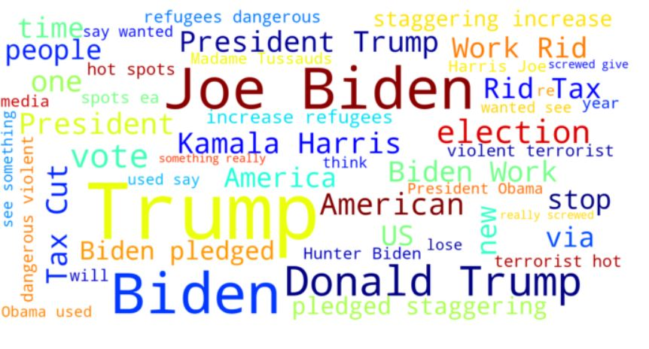
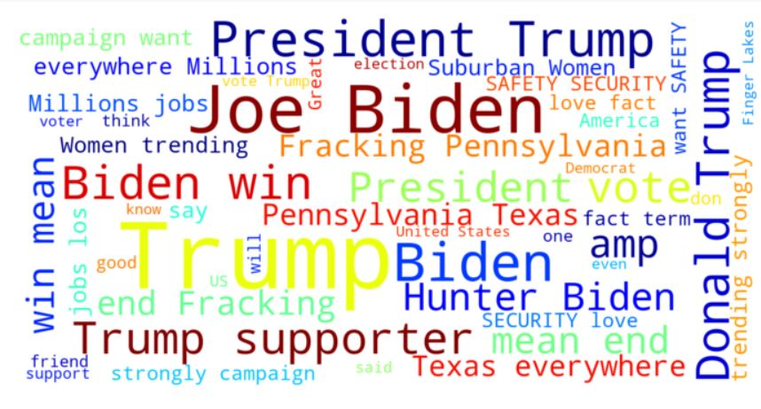
Results
Word cloud in Positive Tweets
Word cloud of negative Tweets

Slide 9
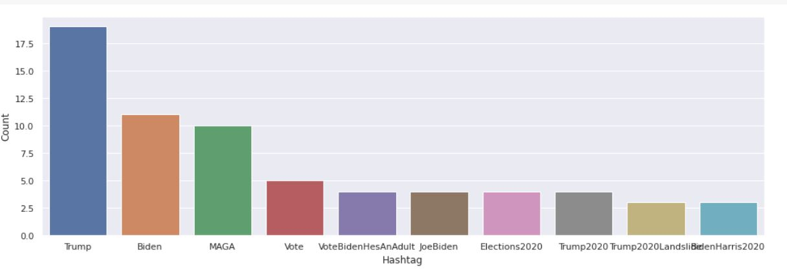
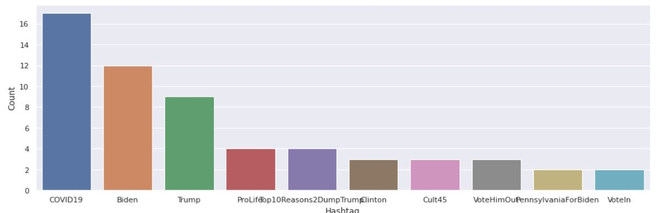
Mentions count in positive hashtags
Mentions count in negative hashtags

Slide 10
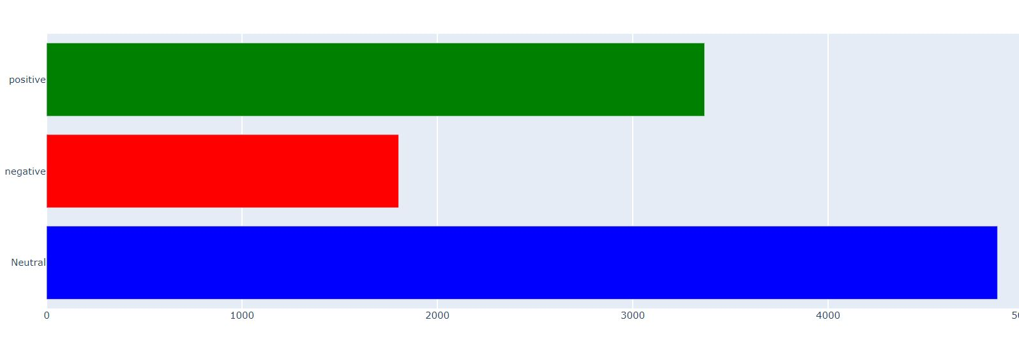
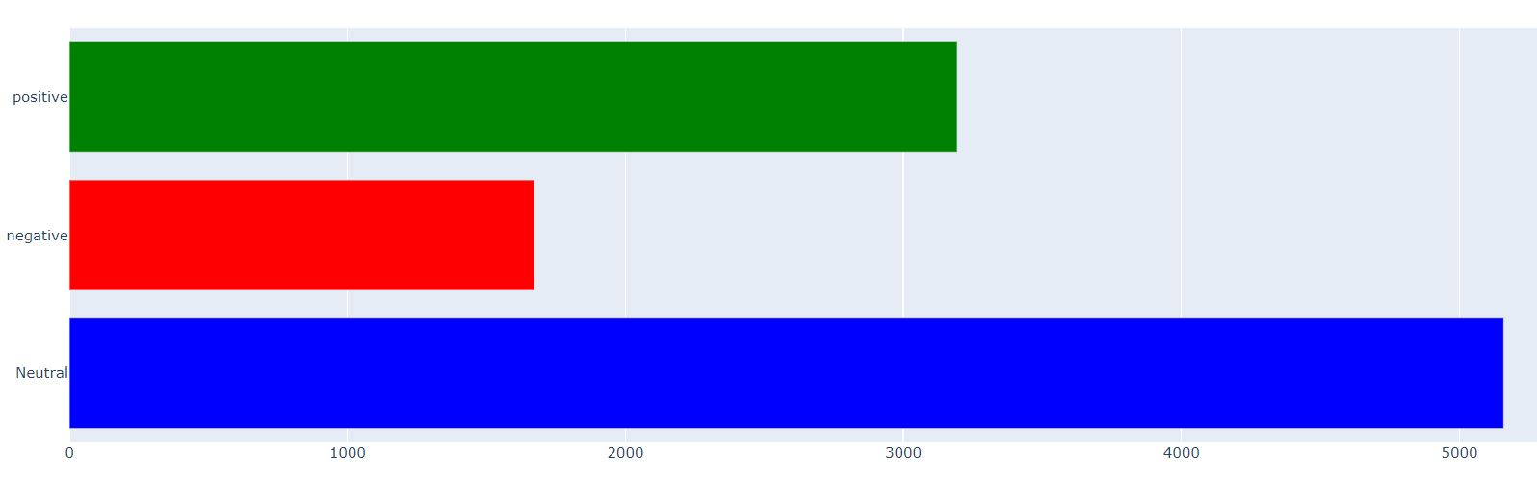
Positive, Negative and Neutral
Count of Trump Dataset
Positive, Negative and Neutral Count of Biden Dataset

Slide 11
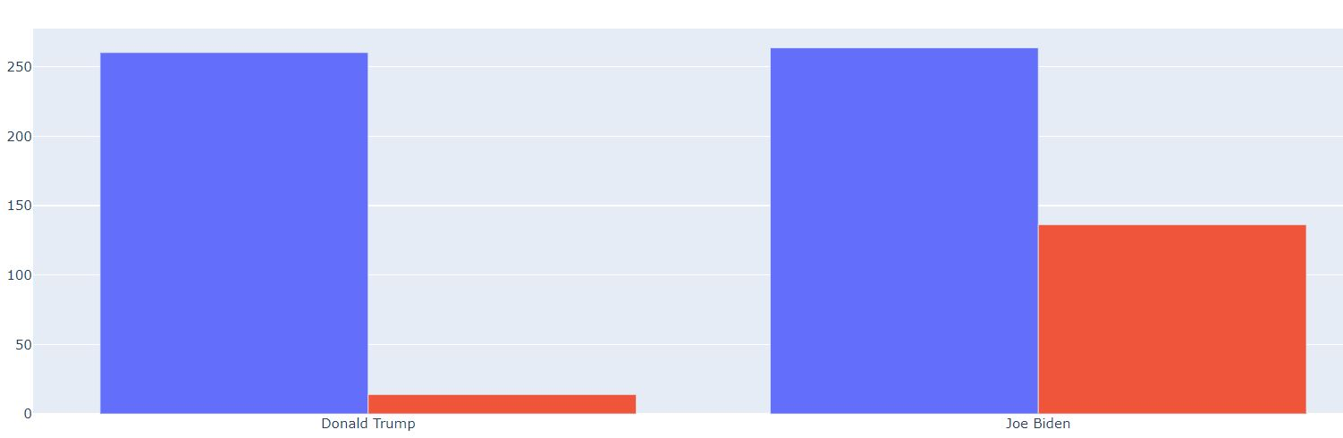
After Scaling same number of tweets

Slide 12
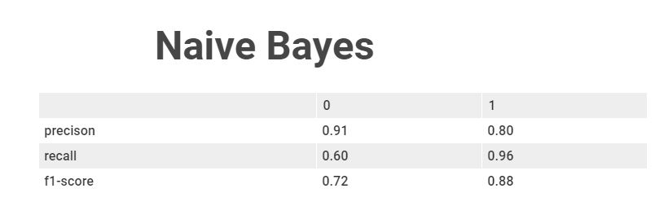
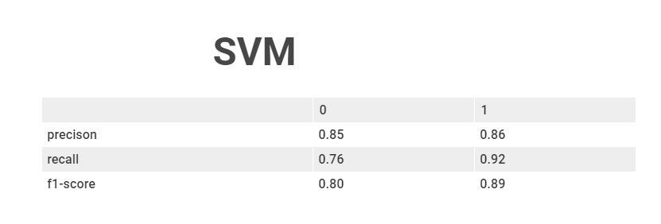
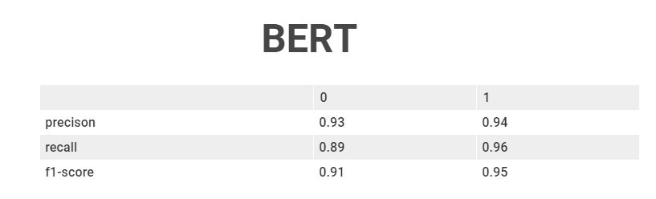

Slide 13
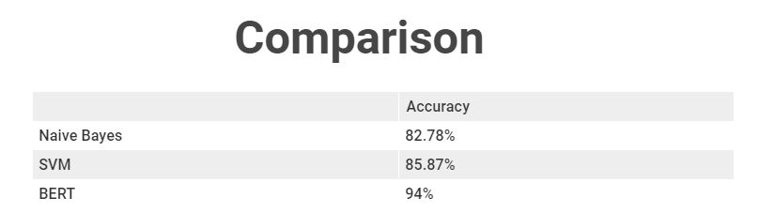
Accuracy of Different Methods

Slide 14
Online Opinion Poll platform for anyone who wants to see the mood of the public before any election.
This will be a challenge as we’ll have to deal with different languages then but hopefully it will be another good learning experience for us.
Future Prospects
And
Conclusion
From research based to product based

Slide 15
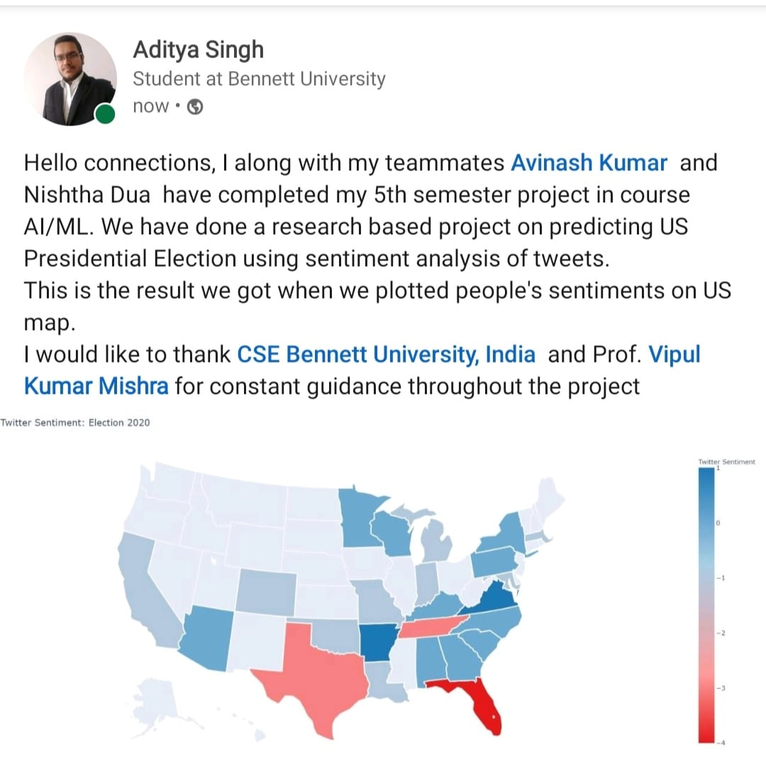
Social Media Posts

